Slide 1


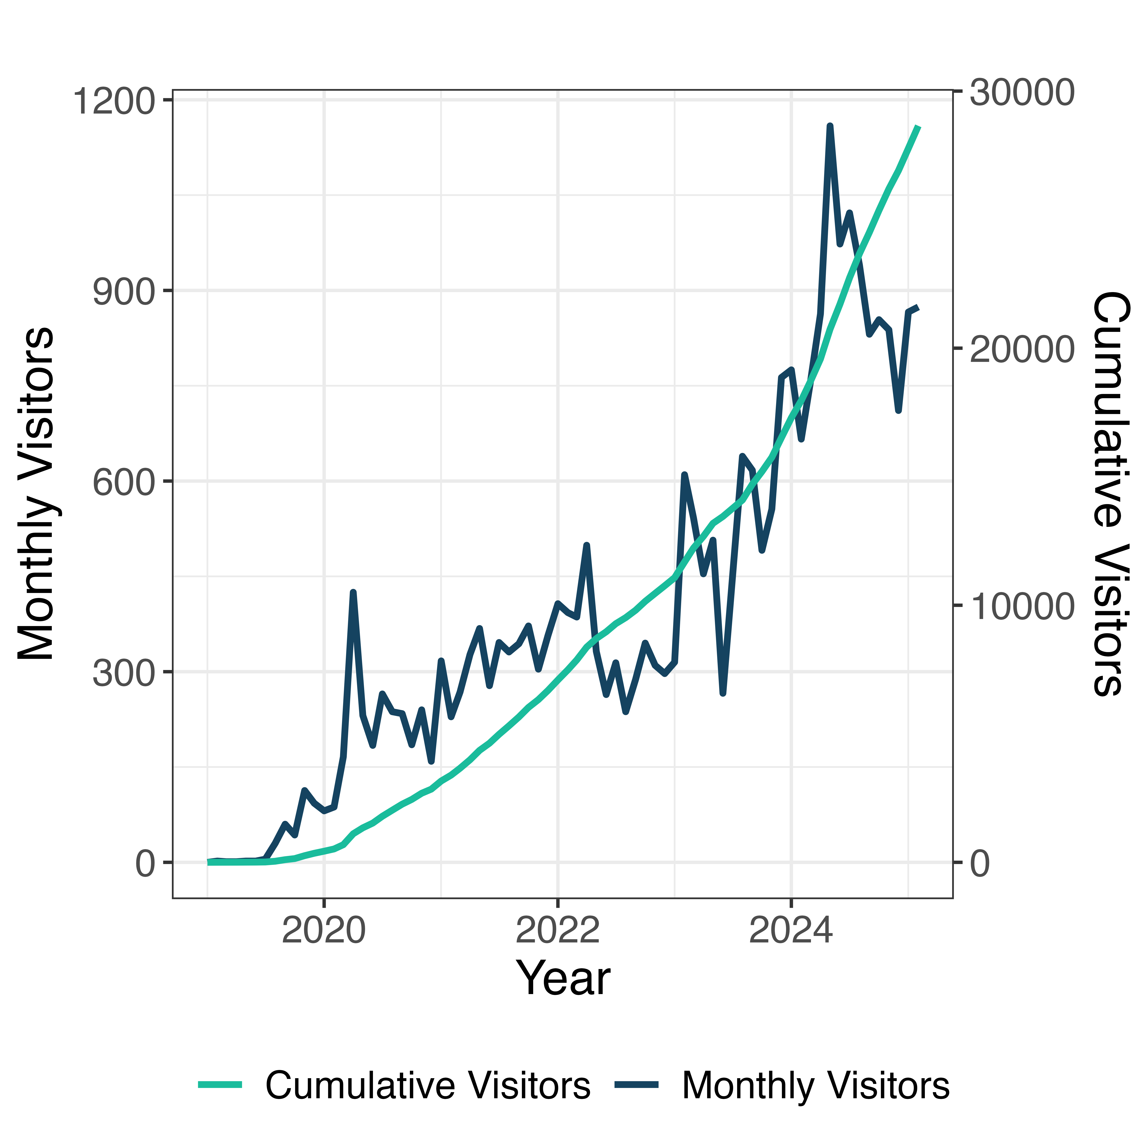
References:
SPOKE: Mapping Biomedical Knowledge for Precision Medicine and Genomics
¹John H Morris, ¹Wanjun Gu, ¹Karthik Soman, ¹Rabia E Akbas, ²Brett Smith, ¹Gabriel Cerono, ¹Braian Peetoom, ¹Catalina Villouta-Reyes, ¹Gundolf Schenk, ¹Angela Rizk-Jackson, ³Lauren Sanders, ³Sylvain V Costes, ¹Yongmei Shi, ¹Sharat Israni, ²Sui Huang, ⁴Peter W Rose, ⁵Charlotte A Nelson, ¹Sergio E Baranzini
¹University of California, San Francisco ²Institute of Systems Biology ³NASA ⁴University of California, San Diego ⁵Matebio.ai
Introduction
Infrastructure
Applications
Vast amounts of biomedical data are being generated at an unprecedented rate, leading to rapid growth in databases and repositories. Biomedical information is fragmented across disciplines due to the complexity of human physiology, limiting accessibility and interpretation.
Knowledge graphs are gaining traction as a method to integrate disparate biomedical data sources and facilitate knowledge discovery. The biomedical field requires a structured approach to connect diverse datasets and overcome compartmentalization. Connecting relevant biomedical information could lead to new insights in disease understanding, drug discovery, and personal health.
To this end, we introduce SPOKE (Scalable Precision Medicine Open Knowledge Engine): A heterogenous biomedical knowledge graph linking molecular biology, pharmacology, and clinical practice. By connecting diverse biomedical information, SPOKE aims to facilitate knowledge emergence, enhance disease understanding, improve drug discovery, and support personalized healthcare.
Method
Source | Node Type
Cell Ontology | CellType
Disease Ontology | Disease
DrugBank, ChEMBL, KEGG | Compound
DrugCentral | PharmacologicClass
Entrez Gene | Gene
Enzyme Commission | EnzymeticActivity
FoodOn | Food
Gene Ontology | BiologicalProcess, CellularComponent, MolecularFunction
Geonames, Location databases | Location
MeSH, HPO | Symptom
MiRDB | MiRNA
NCBI Taxonomy, BV-BRC | Organism
NHANES | Blend, DietarySupplement
Pathway databases | Reaction
Pfam | ProteinDomain, ProteinFamily
SIDER | SideEffect
Uberon | Anatomy
UniProtKB | Protein
WikiPathways, Reactome, KEGG, MetaCyc | Pathway
- SPOKE Aggregates data from 51 specialized databases across multiple biomedical domains.
- Data is structured into 33 node types (e.g., genes, proteins, diseases, pathways) and 90 edge types (relationships between nodes).
- Weekly updates for most data types, with some static sources.
Figure 3. Integrating electronic health record (EHR) data into SPOKE for precision medicine. Multi-modal patient data (e.g., genotype, lab tests, diagnoses, medications, microbes) is embedded into the SPOKE knowledge graph, enabling network-based patient representations. These embeddings facilitate personalized disease progression prediction, subtyping, and diagnostics, supporting data-driven precision medicine.
Figure 1. Schematic of SPOKE. Structure of the SPOKE knowledge graph, illustrating the interconnected biomedical entities across five hierarchical domains: Environmental and Exposure, Physiological/Pathological Process, Cellular Process, Proteins, and Genetics/Genomics. Nodes represent biological and medical concepts, while edges denote relationships between them, enabling integrative biomedical insights.
Network Structure and Knowledge Graph Design
Heterogeneous Network: Nodes represent different data types; edges define known relationships.
Hierarchical Organization: Directed edges indicate hierarchies (e.g., disease subtypes, anatomical relationships).
Semantic and Functional Connectivity: Identifies unknown connections by linking previously unrelated nodes through multi-step paths.
Figure 4. Integration of SPOKE with a large language model (LLM) using a retrieval-augmented generation (RAG) system. When a user queries a biomedical concept (e.g., "What genes are associated with Multiple Sclerosis?"), the system retrieves relevant subgraphs from SPOKE, providing structured contextual information to the LLM. The LLM then synthesizes an informed response based on graph-derived knowledge, enabling accurate and interpretable answers to biological and medical inquiries.
Table 1 (left). A representative list of data sources of all nodes in SPOKE
Source | Edge Types
Bgee | Anatomy-expresses-Gene
BindingDB, DrugCentral, ChEMBL | Compound-binds-Protein
BioGRID, STRING, IntAct | Protein-interacts-Protein
ChEMBL, DrugCentral | Compound-treats-Disease
ClinVar, GWAS Catalog | Variant-associates-Phenotype
Gene Ontology, Pathway Commons | Gene-participates-Pathway
MiRDB | MiRNA-targets-Gene
OMIM, GWAS Catalog, DISEASES | Disease-associates-Gene
TFLink, TRRUST, ReMap | Protein-regulates-Gene
UniProt | Gene-encodes-Protein
Other Applications: A subnetwork of SPOKE has been adapted into a pathway analysis tool, enabling the interpretation of omics data (transcriptomics, metabolomics, proteomics) to uncover molecular biology insights.
Figure 5. Growth in SPOKE's popularity over time. The dark blue line represents the number of monthly visitors, showing an increasing trend with fluctuations. The green line represents cumulative visitors, indicating a steady rise in SPOKE’s user engagement and adoption since its inception.
Table 2 (down). A representative list of Data sources of all edges in SPOKE
Figure 2. Overview of SPOKE's infrastructure and applications. The infrastructure integrates UCSF Versa with large language models (LLMs) and a web interface. Key applications include microbiome research, drug repurposing, genetics, social determinants of health (SDoH), precision medicine (Px/Dx), and drug discovery.

